Slide 1
Overview and Introduction
NE 533: Nuclear Fuel Performance
Spring 2025
Dr. Benjamin Beeler

Slide 2
Overview

Slide 3
Access to Course Resources
Everything will be hosted on Moodle, classes conducted in-person and via Zoom
To access Moodle courses, log on to WolfWare with your Unity ID and password
Lecture recordings will be available via Panopto
Lecture PDFs will be uploaded to Moodle after each class
Office hours will be held in my office on Wednesdays 9-10 am
Additional office hours (in person or virtual) can be scheduled via email
I encourage all to reach out to me with any questions or concerns
Have invited everyone to a Slack channel for ease of communication

Slide 4
Syllabus
Course Overview
In this course we will study the basic role of fuel in reactor operation and understand how the fuel impacts heat generation and transport to the coolant. The course will begin with an overview of different fuels and the fabrication processes required to construct nuclear fuel. This will include various fuel types and geometries, with a focus on light water reactor fuel and cladding. Thermal transport, mechanics, and thermomechanics affecting fuel behavior will be introduced, and methods to solve the governing equations numerically and analytically will be developed. Subsequently, changes in the fuel and cladding material that degrade the performance of the fuel will be examined. Finally, the knowledge gained throughout the course will be utilized to conduct fuel performance simulations with MOOSE.
Learning Outcomes
By the end of this course, the student should be able to:
Summarize the basics of fuel fabrication
Evaluate traditional and alternative nuclear fuel types and their application
Determine the rate at which heat is transported to the coolant from the fuel
Determine the stress state within both the fuel and the cladding
Describe the most important microstructural changes that take place in the fuel and cladding and how they impact fuel performance
Critically analyze existing literature in fuel performance modeling
Use an existing fuel performance code

Slide 5
Topical Outline
Module 1: Fuels, Systems, Heat Conduction Equation, and Numerical Discretization
Module 2: Mechanics, Thermomechanics, and Intro to MOOSE
Module 3: Fission Products, Swelling, and Pellet Cladding Interactions
Module 4: Corrosion, Accidents, and Advanced Fuels
Modules contain 4-5 lectures, with an exam at the end of the module
Graded Exercises
Four exams (64%)
One paper presentation project (16%)
One MOOSE-based project (in three parts) (20%)
Please note: the course schedule is subject to change.

Slide 6
Exams, Projects, Grading
Using the standard NCSU +/- grading system
Four exams will be conducted closed book (with cheat sheet) and held during normal class hours
Will work with distance students to schedule exams
Will do problem session lecture prior to exam periods
Project presentations will be via PPT and conducted during normal class hours
No final exam

Slide 7
Paper Project
Will assign a paper related to the course
Will deliver a 15-minute presentation providing a critical review of the paper
This is basically a mini QE Part 1, without the report
If you have a topic that you want the paper to address, I will do my best to accommodate that
Will occur around the midpoint of the semester
Accounts for 16% of your grade

Slide 8
MOOSE Project
Computational project will be via MOOSE, where code will be submitted in addition to a writeup
Project is split into 3 parts, each with a submission
The submissions are building upon each other
Submission 1 = Part 1; Submission 2 = Part 1+ Part 2; Submission 3 = All three parts
Grading is performed on the entirety of each submission
Thus, you need to fix mistakes made in Part 1 for subsequent submissions
MOOSE project is 20% of your grade, with Submission 1 = 5%; Submission 2 = 5%; Submission 3 = 10%
I am being this granular because some of this has been unclear previously

Slide 9
Feedback
No course is static, and I need your feedback to modify/update the course to meet the needs of the students
I will be reaching out for feedback periodically throughout the semester
Completion of feedback will gain extra credit (+5) on exams

Slide 10

Brief Bio/Background
Computational Nuclear Materials Scientist
Expertise in advanced nuclear fuels
Ph.D. in Nuclear Engineering from Georgia Tech
Previously a staff scientist at Idaho National Laboratory in Fuel Modeling and Simulation Group
Atomistic simulations: density functional theory and molecular dynamics

Slide 11
My viewpoint/approach
Scientifically informed engineering is a multiscale problem
Critical phenomena need to be identified from the macroscale, and informed from the lower length scales
Perform good science, sometimes for science’s sake, but often to address a key engineering problem or need

Slide 12
tell me about yourself

Slide 13
Introduction

Slide 14
Complete nuclear fuel cycle

Slide 15
Emphasis on In-Reactor Behavior of Fuel
The full reactor system is complex and substantial, and there are separate NE courses covering this area
Although the fuel is a relatively small part of a reactor system, it determines thermal power, which drives electric power generation
The performance of the fuel is measured by:
How much heat is delivered to the coolant
The length of time it operates without any problems
How well it performs during an accident

Slide 16
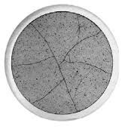
How much heat is delivered to the coolant?
Heat transport is related to thermal conductivity
In single crystal, pristine materials, thermal conductivity is reasonably straightforward
In dynamic, radiation environments, thermal conductivity degrades, fission gas bubbles form, grain boundaries are generated and destroyed, changing geometries, evolving chemical compositions, etc.
How does thermal conductivity vary?

Slide 17
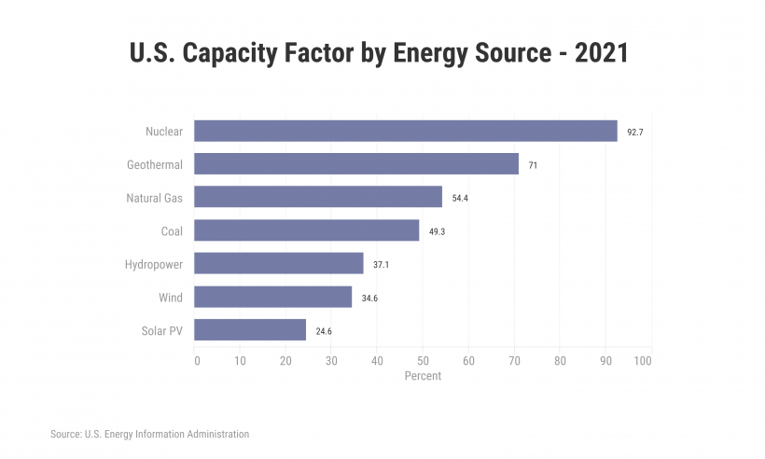
The length of time fuel operates without any problems
There are 92 operating nuclear reactors in the US, producing ~20% of the electricity
The net capacity factor is the ratio of an actual electrical energy output to the maximum possible electrical energy output over a period of time
Nuclear reactor capacity factor is ~92% over the past decade
The ability to maintain high capacity factor, largely by limiting shutdown time, is key in making nuclear power economical
Fuel is the primary component forcing reactor downtime

Slide 18
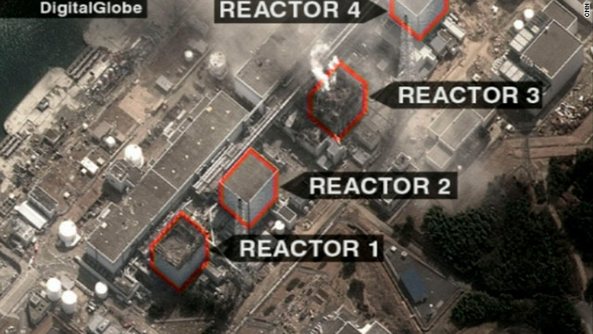
Fuel behavior during accidents
Fukushima
In addition to normal operating conditions, the behavior of the fuel during accidents is of critical importance
Predictable, and hopefully stable, behavior is desired during a variety of accident scenarios
Even low impact accidents are detrimental to public opinion surrounding nuclear energy

Slide 19
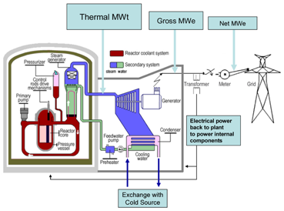
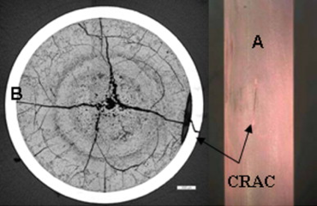
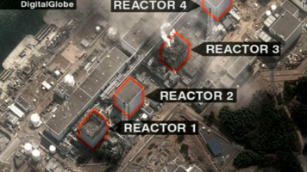
All of these factors together represent what we call “fuel performance”
Fuel Performance
Heat generation
Fuel problems causing unscheduled outages
Fuel behavior during an accident

Slide 20
Fuel types

Slide 21
Fuel is the Heat Source
Fuel functions as a heat source, generating heat that is transferred to a coolant, which transfers heat through external loops, heat exchangers, etc., to run a generator

Slide 22
Fuel is limited to select elements
A fissionable nuclide is capable of undergoing fission (even with a low probability) after capturing a high energy neutron
A fissile nuclide is capable of sustaining a nuclear fission chain reaction with neutrons of any energy
A fertile material is a material that, although not itself fissionable, can be converted into a fissile nuclide by neutron absorption and subsequent nuclei conversions.
The Ronen fissile rule states that for a heavy element with 90 ≤ Z ≤ 100, its isotopes with neutrons (A-Z) = 2 × Z – N, where N = 43 ±2 are fissile (with some exceptions)

Slide 23
Potential fuel candidates
The heavy elements with 90 ≤ Z ≤ 100
Thorium (Th), Protactinium (Pa), Uranium (U), Neptunium (Np), Plutonium (Pu), Americium (Am), Curium (Cm), Berkelium (Bk), Californium (Cf), Einsteinium (Es) and Fermium (Fm)
Lets apply the fissile rule to U (2 × Z – N)
(A-Z) = 2 Z – (43 ± 2)
(A-Z) = 2 × 92 – [41, 42, 43, 44, 45] = [143, 142, 141, 140, 139] neutrons
So, U-231 through U-235 should be fissile

Slide 24
There are only four fissile nuclides that are practical for nuclear fuel
U-235
Naturally occurs in uranium in small amounts (0.7%). Can be enriched
Pu-239
Bred from U-238 by neutron capture
Pu-241
Bred from Pu-240 (which comes from Pu-239) by neutron capture
U-233
Bred from Th-232 by neutron capture

Slide 25
Fuel Considerations
Safety:
Stable and predictable behavior
No melting, no phase changes under transients that lead to deleterious behavior
Uranium density
Mechanical integrity
Cladding interactions
Swelling and fission gas release
Operating temperatures

Slide 26
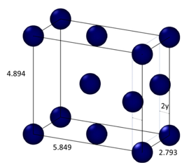
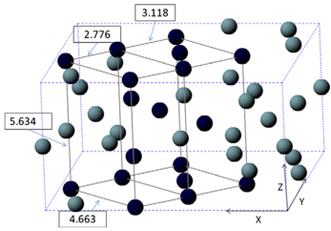
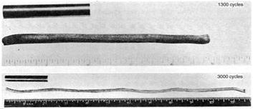
Why not use pure uranium metal?
Pure uranium has three phases
α-phase is orthorhombic
β-phase is tetragonal
γ-phase is body-centered cubic
During thermal cycling, pure uranium dramatically swells
Alpha U has both anisotropic thermal expansion and anisotropic irradiation growth

Slide 27
Fuel Types and Associated Reactor Types
UO2 – Light Water Reactors
Mixed oxide (MOX)
Accident tolerant/Advanced Technology Fuel (ATF)
UZr – Sodium Cooled Fast Reactors
UMo – Research Reactors
UC/UCO – High Temperature Gas Reactors
UN – Lead Cooled Fast Reactors
Other

Slide 28
Uranium Dioxide (UO2)
Reference fuel for nuclear power industry
Single phase, fluorite structure
Fabrication via sintering UO2 powder into pellets
Water coolant
Pellets are stacked inside Zircaloy cladding tubes

Slide 29
Uranium Dioxide (UO2)
Good Characteristics
Very high melting point, about 2800 C
Maintains a stable fluorite phase up to melting
Very compatible with Zircaloy clad (no interaction zones forming/no FCCI)
Relative stability in water
Reasonably radiation resistant
no amorphization
Can incorporate a large number of fission products as substitutional defects

Slide 30
Uranium Dioxide (UO2)
Bad Characteristics
Brittle (thermal stress fractures, fragmentation)
Poor thermal conductivity
Properties very sensitive to stoichiometry
Limited linear heating rates
Non-negligible thermal expansion/swelling
Higher stored thermal energy than other fuel materials

Slide 31
Uranium Dioxide (UO2)
Critical Phenomena
Thermal conductivity (and degradation)
Fission gas release, leading to pressure increase inside the cladding
Fuel fragmentation and relocation under transients
Bambooing creating stress concentrations
All operational reactors in US utilize UO2

Slide 32
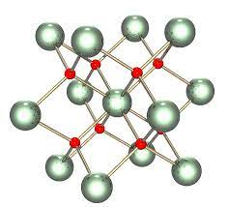
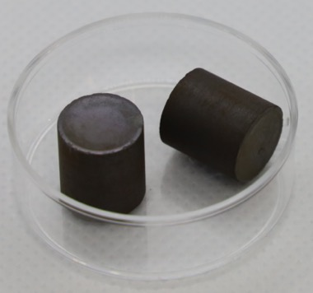
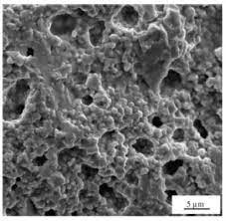
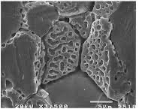
Uranium Dioxide (UO2)
The majority of this course will focus on UO2 fuels and the associated reactor materials for UO2 application in LWRs
Material properties, challenges, and phenomena associated with these systems
We will get to some discussion of advanced fuel concepts later in the term

